Slide 1





14 March 2026
9:00 AM – 16:40 PM CST
Harbour Space Barcelona, Spain
Sponsored by:

Slide 2
Thanks to our sponsors

Slide 3
Top Donations
Jaime Arroyo
Daniil Dranga
Juan Bacardit

Slide 4
Organizer Team

Slide 5
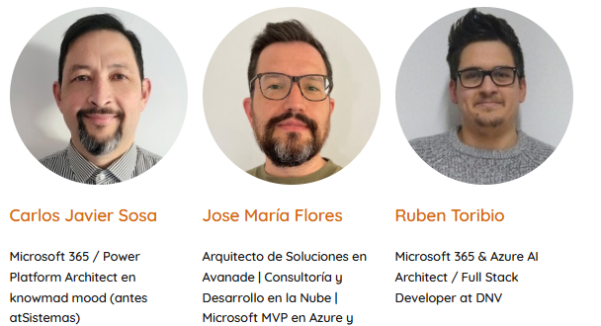
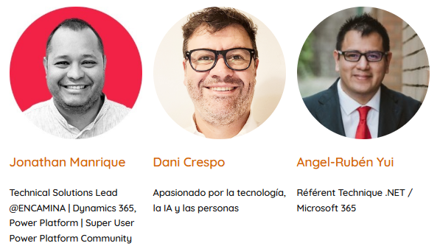
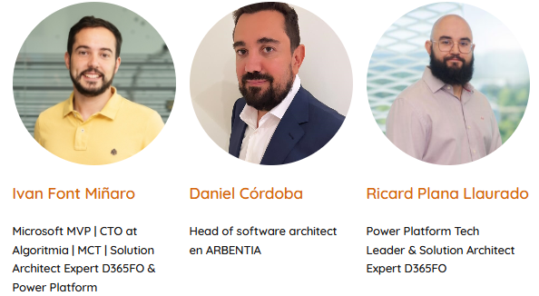

Slide 6
Venue
Floor 6 – Sessions (Not possible to eat here)
Floor 1 - Coffee Break and Lunch
Basement – Cafeteria
If you have any intolerance, please contact staff, to list it.
Sala 1 –> Open Space
Sala 2
Sala 3
Networking Area
Sponsors / Goodies Area

Slide 7
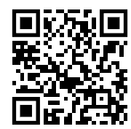
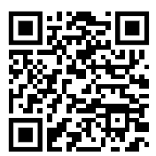
Schedule
https://globalaibarcelona.es/schedule/
https://agentcamp-barcelona-2026.sessionize.com/

Slide 8
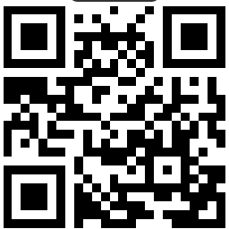
Information
Website:
https://globalaibarcelona.es/
Social Networks:
https://www.linkedin.com/in/global-ai-barcelona/
https://x.com/GlobalAIBarna

Slide 9
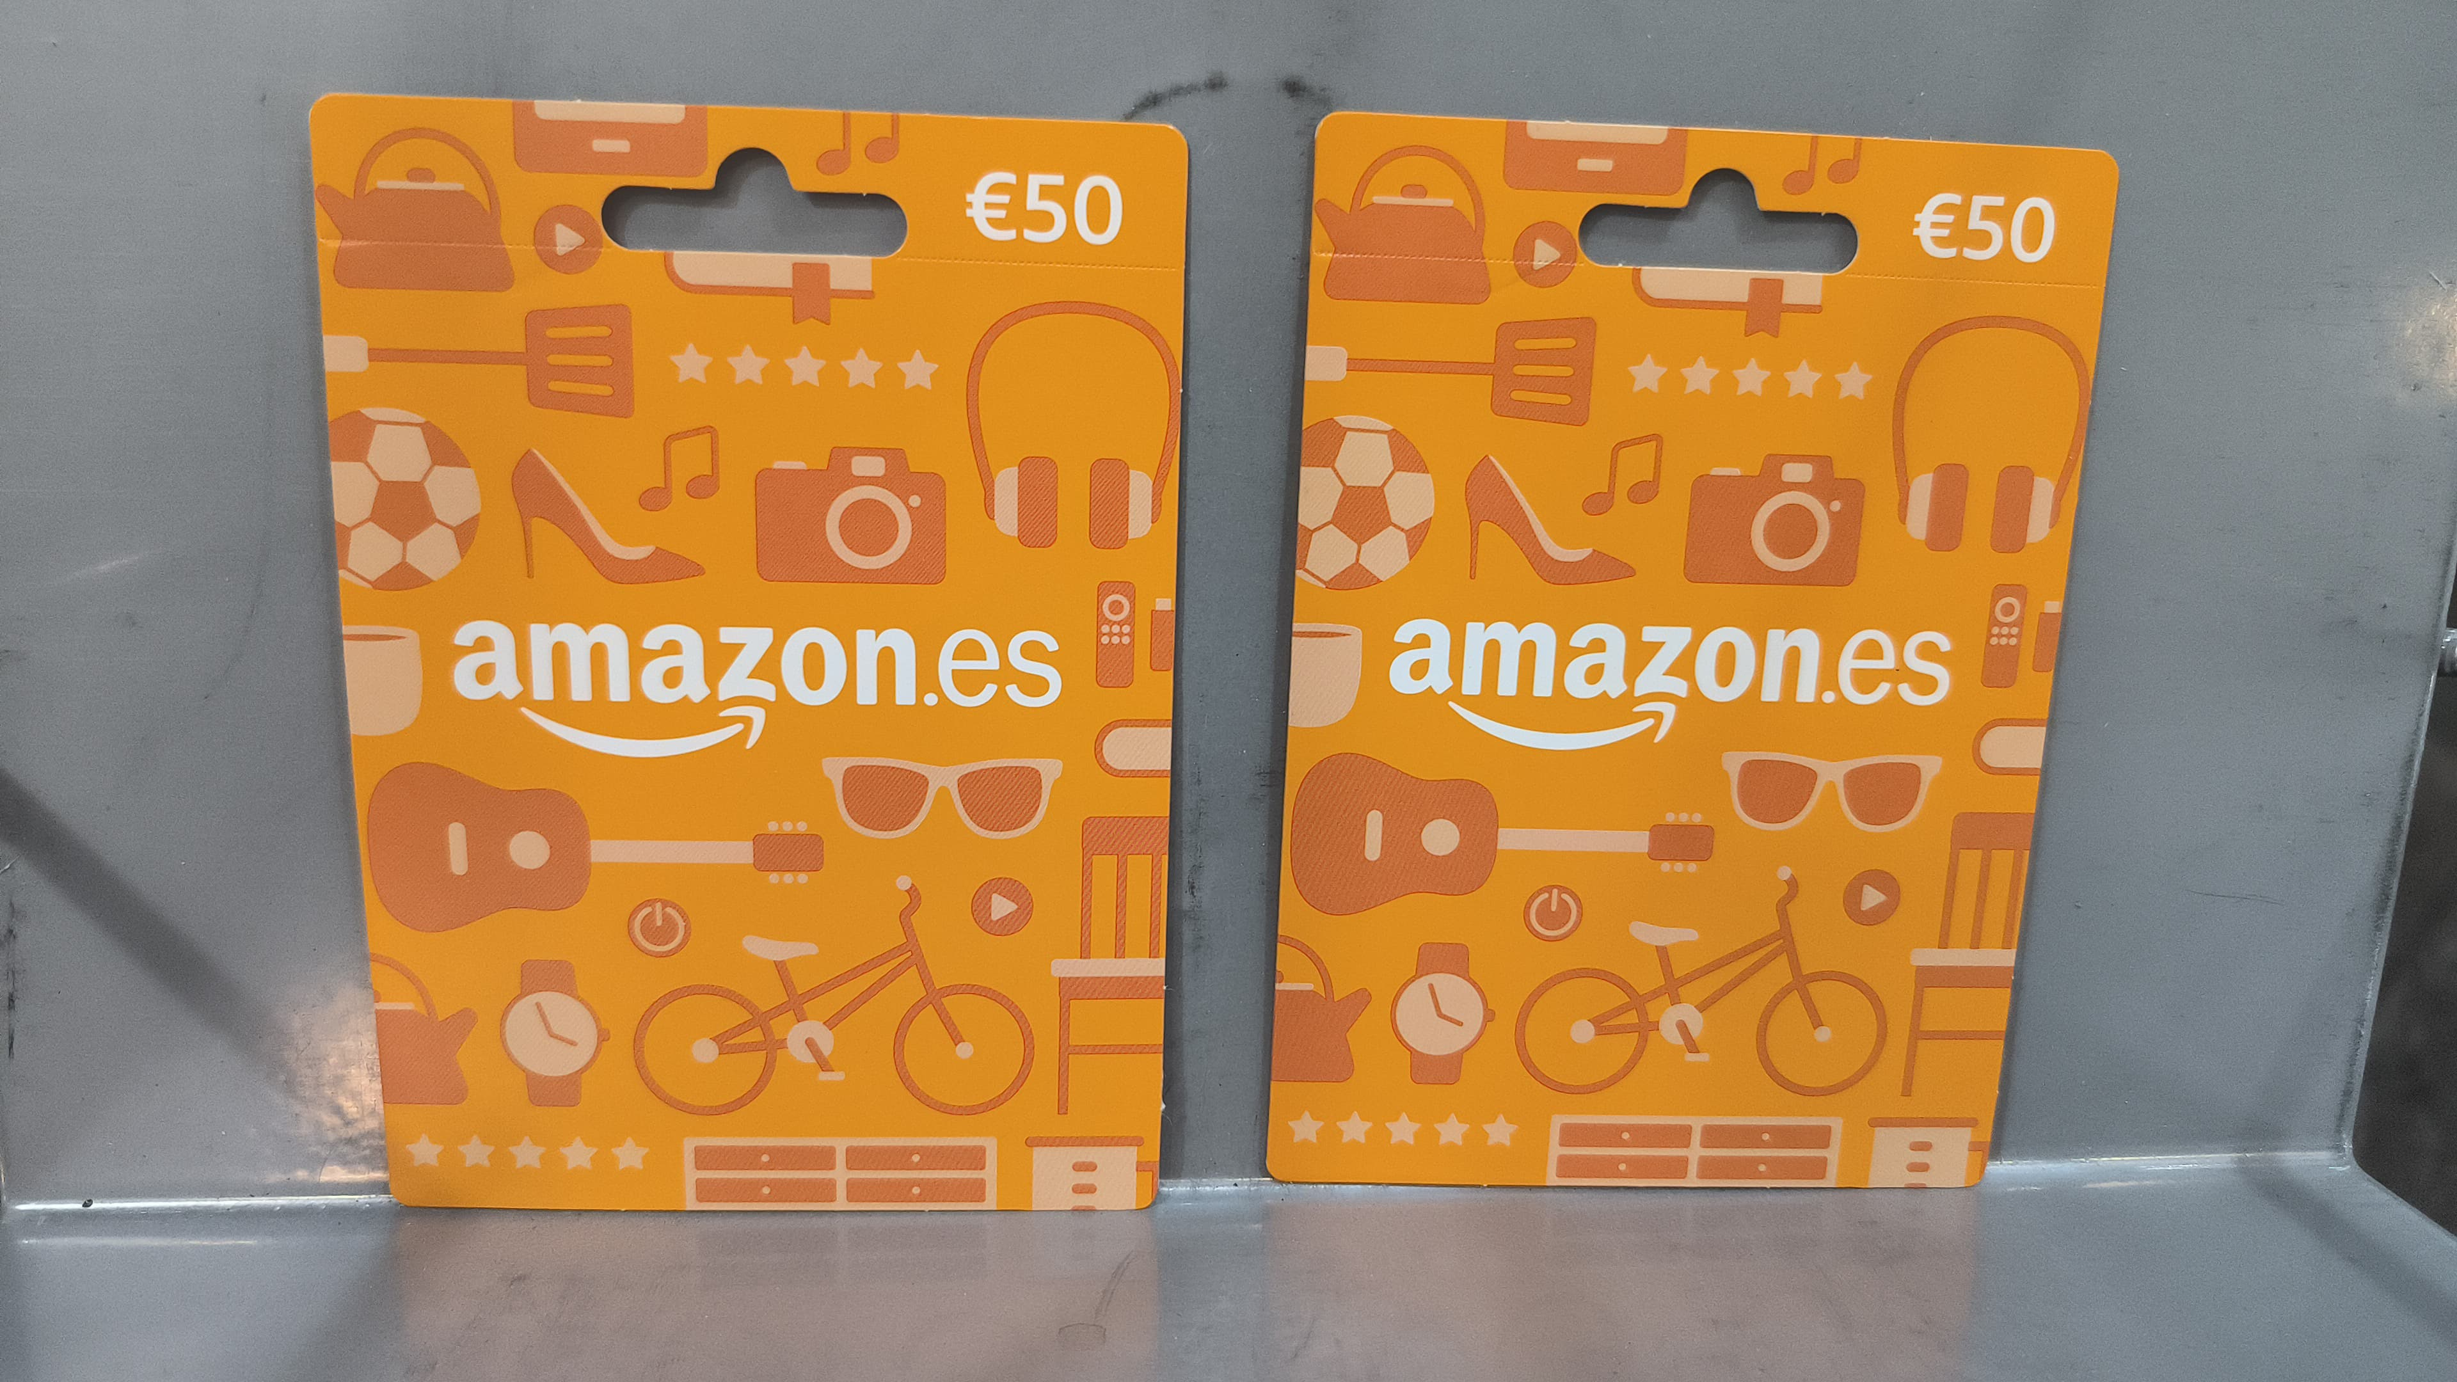
Raffle
Be present at the event during the raffle. (Not staff, speakers)
1 Post on LinkedIn or X mentioning our account.
https://www.linkedin.com/in/global-ai-barcelona/
4 x 50 € Amazon gift card

Slide 10
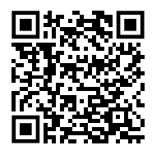
Github Repository
https://github.com/Global-AI-Barcelona/AgentCamp2026

Slide 11
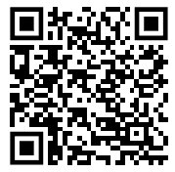
Digital Badge
https://globalai.community/badges/agentcamp-speaker/

Slide 12
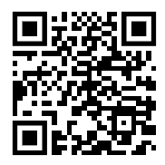
Feedback

Slide 13
AgentCamp Community

Slide 14
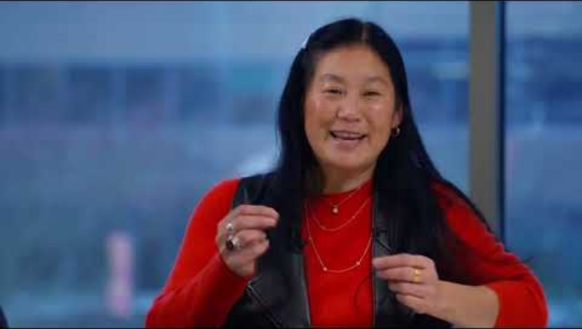

Slide 15
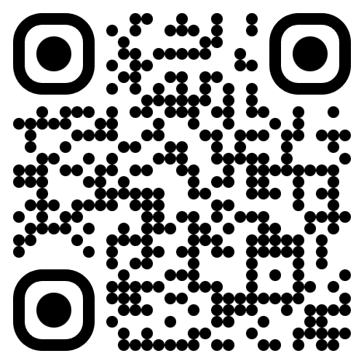
Join the AI Conversation on Discord
gaic.io/discord

